Slide 1

Personal Finance Savings Predictor
By: Husain Hashemi - 20222727

Slide 2
Project
Overview
Objective
Simplify personal finance management.
Predict savings trends using machine learning.
A web application that helps users plan their savings by analyzing their income and expenses. The application predicts savings and provides recommendations for achieving financial goals.
Key Features
Expense traking.
Income categorization.
Predict future savings.

Slide 3








Technologies Used
Frontend
Backend
HTML, CSS, JavaScript
Chart.js for visualizations
Flask (Python Framework)
Pandas for data manipulation
Scikit-learn for Machine Learning
Libraries
Database/Storage
pandas, numpy, scikit-learn, pickle, matplotlib.
CSV files or databases for storing transaction data.

Slide 4


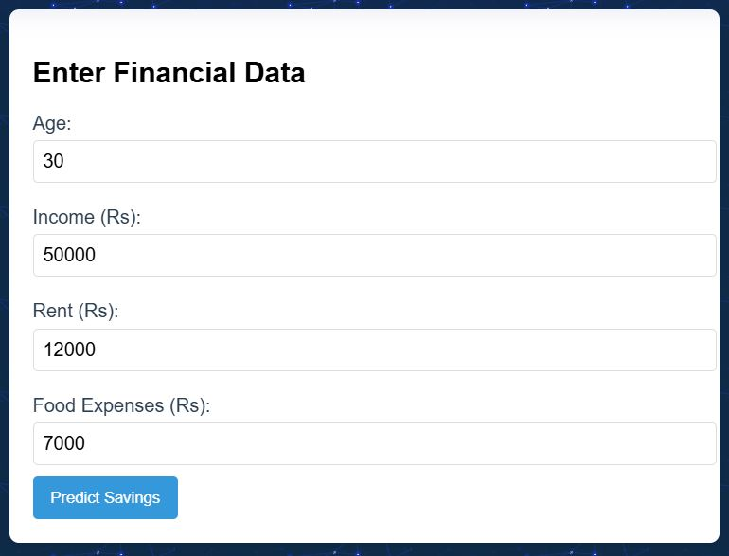
Features
Expense Tracking:
Categorize expenses into Food, Rent, etc.
Savings Prediction:
Predict users’ savings based on their habits.
Visualization:
Simple, user-friendly interface for data input and visualization
Backend API:
Robust RESTful API to handle predictions using a ML Model.

Slide 5
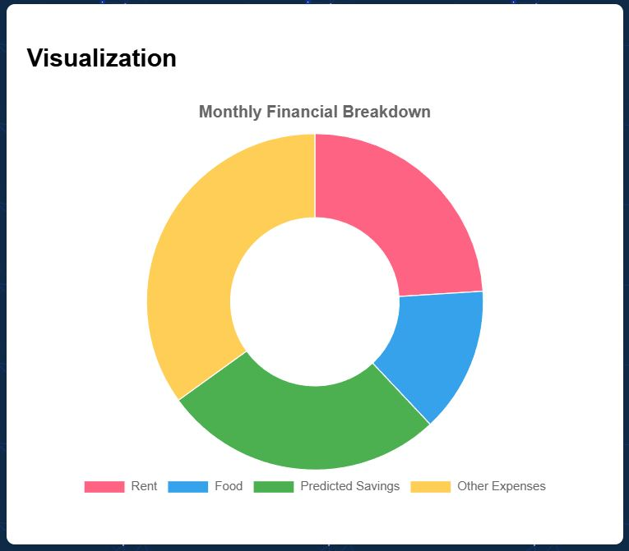
Machine Learning Model
Model Used: Linear Regression
Training Data: Used scikit-learn to train the model and used MSE to evaluate the model’s performance.
Data Visualization: Used matplotlib and pandas to manipulate and analyse the datasets.
Flow Diagram:
Inputs: Age, Income, Rent, Food expenses.
Output: Predicted Savings

Slide 6

Future Plans
Expansion Goals
Additional Features
Time-bound savings predictions for specific goals (e.g., buying a car).
Mobile app integration.
Investments module for stocks and funds.
Bank account synchronization for automated tracking.
Risk analysis for financial decisions.
Goal prioritization and progress tracking.

Slide 7
Conclusions
Our project simplifies financial management and provides actionable insights using technology.
The model’s predictive ability empowers users to achieve their financial goals efficiently.
Call to action:
Interested? Checkout my Github Repository
https://github.com/husainl337/Minor-Project.git
THANK YOU!

